Slide 1
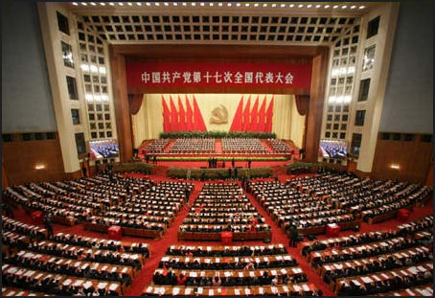
Welcome Shenyang National People’s Congress Delegates!

Slide 2
Providing for the Future of China’s Economic Growth
A presentation to the Shenyang National People’s Congress
By Comrade Craig Pike

Slide 3
Overview
Review of China’s growth since 1980
Limitations to future growth
Policy recommendations

Slide 4
Summary of Conclusions
High growth driven by investment and exports
Few signs of decline, but…
Limitations to Future Growth
  End of rural surplus labor
  Diminishing returns to capital investment
  Inefficient banking sector
  Dependence on exports and (slower) world GDP

Slide 5
Summary of Conclusions (cont)
Policy Recommendations
  Anticipate slow-down in economic growth
  (Future growth increasingly dependent on technology gains)
  Increase focus on domestic economy
  Encourage more market-oriented banking system

Slide 6
Part I
Review of China’s growth
  High growth rates
  Growth driven by investment and exports

Slide 7
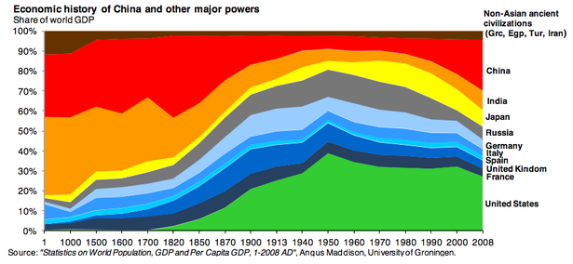

Slide 17
Part II
Limitations to previous growth model
  Decline in “surplus” rural labor leading to diminishing returns to capital investments
  Inefficient banking sector
  Unsustainable growth in exports

Slide 25
Part III
Policy Recommendations
  Anticipate slower future growth
  Continue seeking ways to develop technology improvements
  Shift focus to developing domestic consumption
  Carefully open banking sector up to market forces

Slide 26
Conclusions
Unparalleled period of high GDP growth driven by investment and exports
Limitations:
  Rural population tapped out
  Diminishing returns on capital investment
  Inefficient banking sector
  Export growth constrained by world GDP growth
Policy Recommendations for Future Growth
  Need for technological innovation
  Shift focus to domestic economy
  More market-oriented banking sector

Slide 27
U.S.-China Economic Relations
Trade
Economic Rebalancing: Chinese Consumption
Exchange Rate
Investment
Intellectual property/ Trade Secrets
State Owned Enterprises

Slide 28
U.S.-China Economic Relations
Export Controls
Investment and “CFIUS”
  Committee on Foreign Investment in the United States
Infrastructure Development and Financing
Antidumping/ Countervailing Duties

